Slide 1
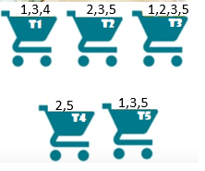
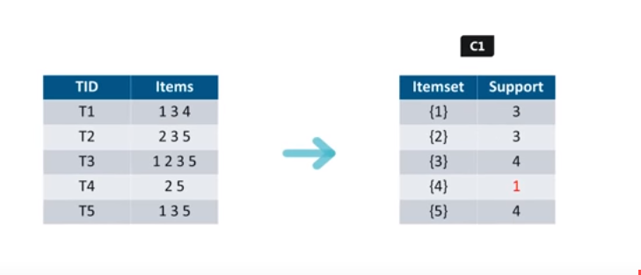
APRIORI ALGORITHM
APRIORI algorithm uses frequent item sets to generate association rules
It is based on the concept that a subset of a frequent item set must also be frequent item set
ITERATION 1

Slide 2
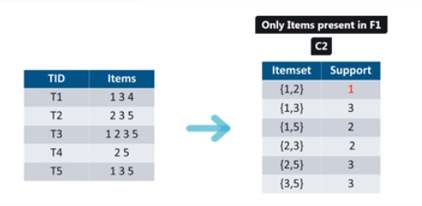
APRIORI ALGORITHM [CONT]
ITERATION 2

Slide 3
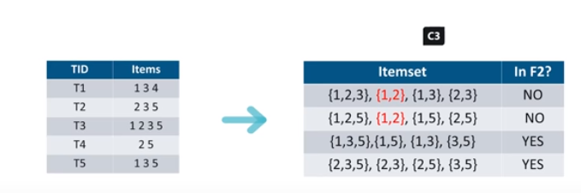
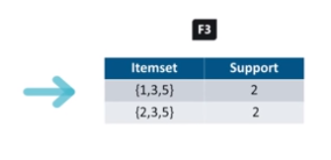

APRIORI ALGORITHM [CONT]
ITERATION 4

Slide 4
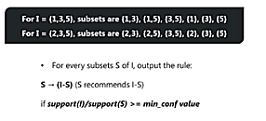
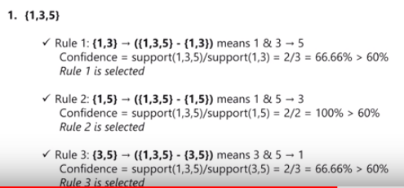
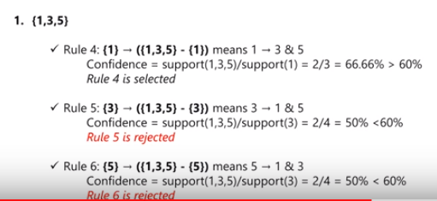
APRIORI ALGORITHM [CONT]

